Slide 1
Psychological Thriller
Phoebe Wright, Olivia Evitt, Lorna Brett-Greenacre & Rosie Smith

Slide 2
What’s the idea?
Synopsis- A psychological thriller in which entails a serial killers obscure obsession with being the ‘fly on the wall’ in homes in which he is not welcome.

Slide 3
Location
Rosie’s cellar – we figured this would be a good idea as it’s a change from the stereotypical dark forest/woods used in other thrillers, yet it’s still eerie, creepy, and extremely old with the connotation of the antagonist being secretive.

Slide 4
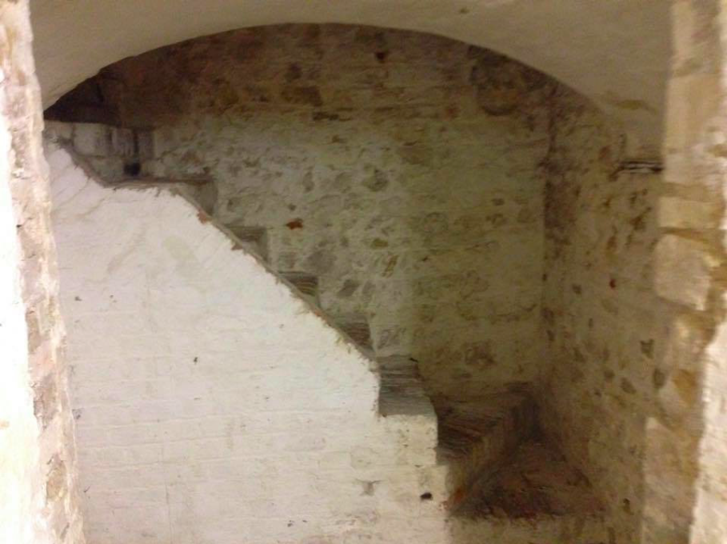
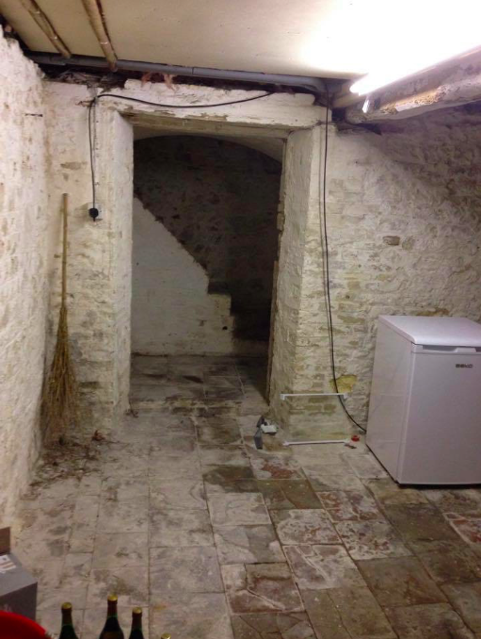
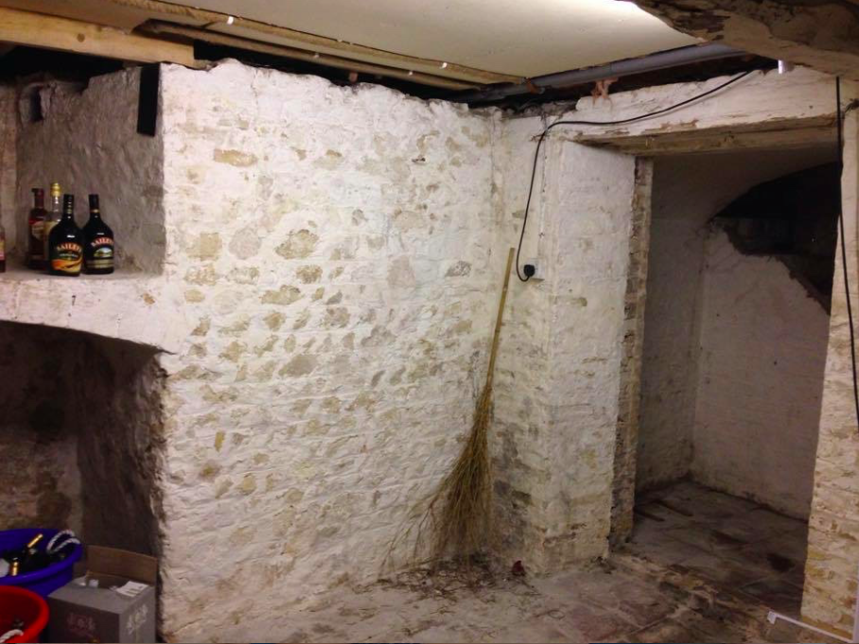

Slide 5
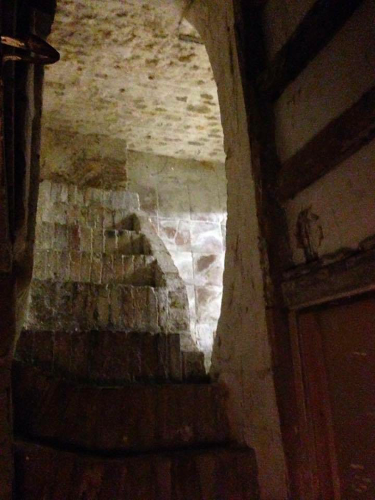
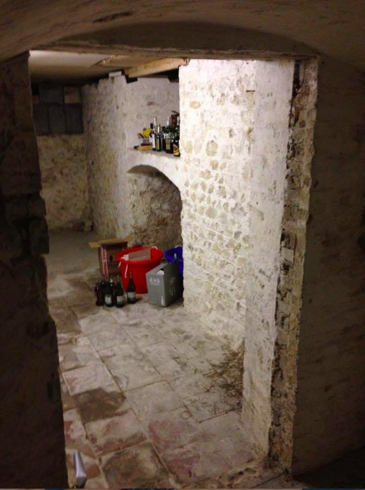

Slide 6
Props – Montage
MONTAGE – we have decided to use a montage as the use of overlaying images infers the antagonist is sugarcoating certain aspects of his ‘plan’.
Crime/investigation styles wall
Photo album of girls
Used chewing gum
Old locks of hair stored in little plastic bags
Swabs of toothbrush
Diary
Facebook photos

Slide 7
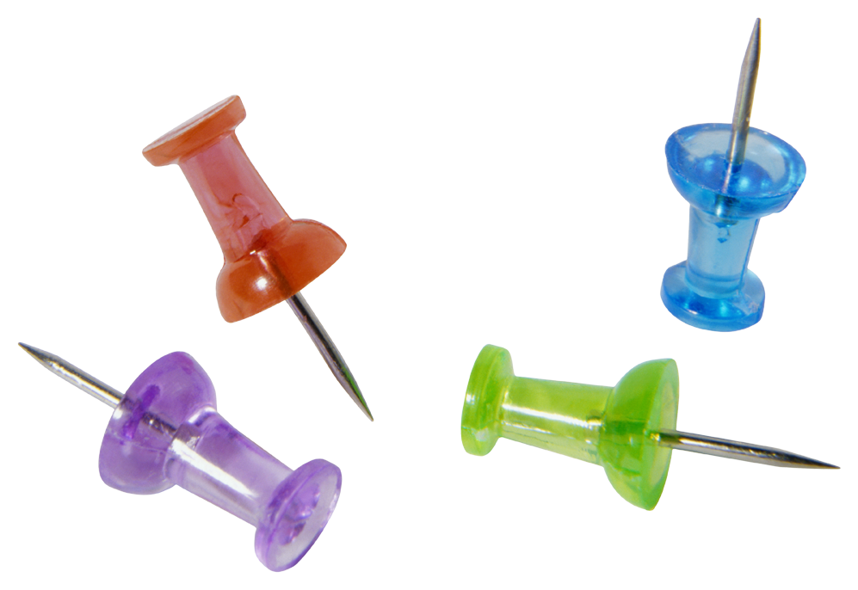

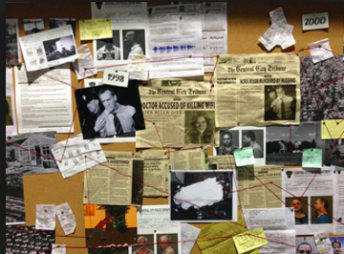

Inspiration for props
This is an example of the kind of ‘investigation’ wall we want to create. It will have images of the girls (protagonists) on that the antagonist has played around with e.g. Facebook photos with eyes cut out, images he has taking himself, cut outs from their diaries, etc. We want to make it look as creepy and as weird as possible.
We will create and old tatty photo album similar to the one shown, although make it more ominous and freaky by adding things like drops of blood. The antagonist will be shown flicking through the photo album, of which will contain photos of the girls since a young age right up until the present.

Slide 8


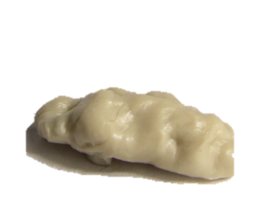
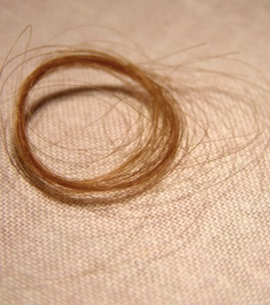
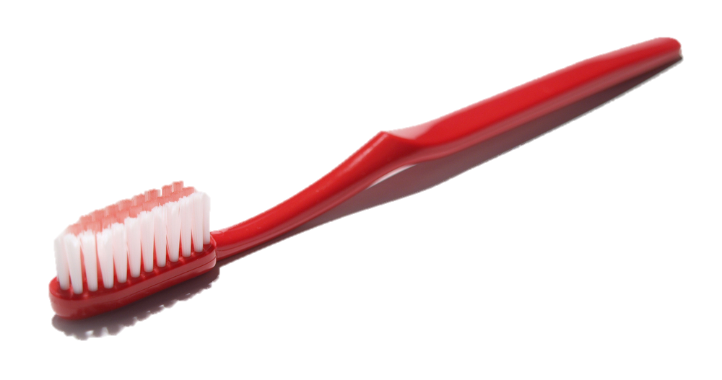
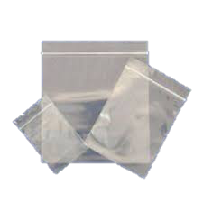
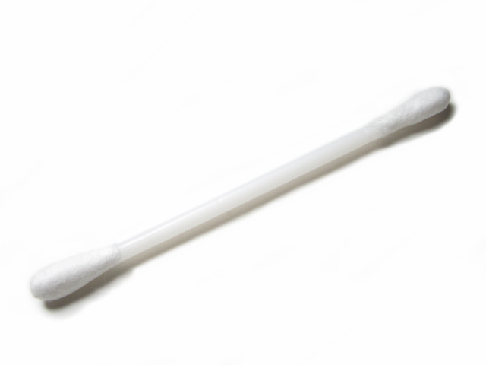
Inspiration for props
We want the antagonist’s obsession with the girls to be as weird as possible, leaving the audience feeling vulnerable, uncomfortable, and threatened. Therefore the montage will show obscure things that he has chosen to build up a collection of e.g. locks of their hair, used chewing gum, swabs from their toothbrush etc. He will be shown placing such things in plastic wallets – like the ones shown.

Slide 9
Other props
We decided the use of mundane props would make it more realistic; therefore leaving the viewers uncomfortable as they will be able to relate to the scenes being shown.
Coffee mugs
TV
Dog
Potted plants on windowsill
Living room furniture
In contrast to this, props used by the antagonist will be the following;
Leather gloves
CCTV cameras

Slide 10
Camerawork
Montage –
Pan shots to show different aspects of the crime/investigation wall. Showing little bits at a time leaves the viewer wanting more.
Layered shots to sugarcoat certain aspects leaving the viewer tense. Also enhances the time spent by the antagonist
Extreme close up on antagonists hands/mouth to never reveal his identity; tension.
Long shots on the yarn wall to show the depth of the case.
Narrative-
Long shots on the protagonists from a high angle POV perspective to make them look vulnerable/weak. Also makes audience feel uncomfortable as they feel as though they are the ones spying/watching them.
Use of 180 degree rule when the two protagonists are engaged in conversation over coffee.

Slide 11
Sound
Only diegetic sound during the narrative (conversation, rustling of camera, dog barking, door bell, coffee cups etc.)
Score used only in montage. Yet to decide whether it will be industrial or orchestral. Asynchronous or synchronous.

Slide 12
Mise-en-scene
Scene in which the protagonists are engaged in conversation over coffee will be set in the living room of a mundane house. The lighting will be high key and natural to show normality and safety. The girls will be wearing everyday clothing which will show no implications, but represent their age.
The lighting during the montage will be low key and unnatural which is sinister and ominous; this will leave us feeling full of fear and tension. The colours used during the montage will be mostly dark (black, browns, etc.) which will add to the eerie, creepy feeling created. The antagonist will be wearing black clothing, accompanied by black leather gloves which instantly portrays danger.

Slide 13
Editing
During the montage, we will edit the different shots so that they overlay each other. This will show a ‘sugarcoating’ effect, as not giving away everything to the audience will create mystery and curiosity.
Long takes will be used during the narrative scene to connote calmness and tranquility. This will therefore leave the audience unprepared for the turn in events.
Fade in and fade outs will be used during the montage to create soft transitions between the images. This will prevent the audience from being able to see the full aspect of each shot, therefore leaving them feeling disorientated and unsettled.

Slide 14
Timings
We consider timing to be important when shooting this film, therefore we have created a plan for each aspect of the overall shooting to ensure the right amount of time is spent.
Filming – aiming for 1 week
Editing – aiming for 3 weeks

Slide 15
Target audience
Our target audience is males and females aged 16-30. We think this is a suitable age range because our thriller is too intellectually demanding for younger audiences, and contains scenes that may be disturbing. We believe the modernity of the film will please an audience up to the age of 30.

